Slide 1
Effect of socio- Economic conditions on life expectancy
Aneesh Patne
MTECH EXTC

Slide 2
Aim of the Research:
Measure the impact of Air Pollution on human health:
Quantify the reduction in the life expectancy caused due to air pollution.
Evaluate Health Standards Enforcement:
Assess how the strict application of existing health standards can enhance the overall health of the country.
Evaluate the prospects of new standards:
Measure how the new policies can affect the life expectancy.

Slide 3
Existing Research
Sr No | Paper Name and Year | Methodology | Conclusion | Learnings / Gaps identified
1 | Wealthier is Healthier" by Lant Pritchett and Lawrence H. Summers 1996 | Regression analysis using panel data from 85 countries over three decades to estimate the impact of GDP on life expectancy. | A 1% increase in GDP per capita results in a 0.05–0.07% increase in life expectancy. | GDP growth has a clear, positive impact on life expectancy, with larger gains in low-income countries.
2 | Economic Growth and Human Development (2020) | Cross-country regression analysis on human development indicators, including life expectancy, with respect to GDP growth | A 1% increase in GDP per capita results in a 0.03–0.05% increase in life expectancy. | The relationship between economic growth and life expectancy is robust but smaller as countries grow wealthier.
3 | Income and Health: Evidence from Microdata on Mortality and Morbidity (2006) | Uses individual-level data from Indonesia to quantify the effects of income changes on mortality and health outcomes. | A 10% increase in household income leads to a 0.5–0.6% increase in life expectancy. | Micro-level income changes have a significant impact on health and longevity, especially in lower-income households

Slide 4
Sr No | Paper Name and Year | Methodology | Conclusion | Learnings
4 | Loss of Life Expectancy from Air Pollution Compared to Other Risks (2020) | Analysis of life expectancy loss due to PM2.5 globally, comparing it to other major health risks using population data. | PM2.5 contributes more to life expectancy reduction than smoking and alcohol in many regions | Highlights the greater impact of pollution on life expectancy in poorer countries.
5 | Air Pollution and National and County Life Expectancy Loss in the USA (2019) | PM2.5 exposure in 1,339 US counties using population-weighted averages. | PM2.5 pollution continues to reduce life expectancy, especially in poorer counties. | Air pollution disproportionately affects economically weaker regions.
6 | Global Burden of Disease Study (2019) | Cross-country analysis of PM2.5 exposure and its effects on life expectancy, with comparisons to cancer mortality. | Life expectancy could increase by up to 0.6 years globally if PM2.5 met WHO guidelines. | Political/regulatory hurdles in low-income nations hinders development.
7 | AQLI 2024 Report | Data from the Air Quality Life Index (AQLI), measuring the impact of PM2.5 on life expectancy across regions, especially in high-risk areas. | On average, PM2.5 reduces global life expectancy by 2 years | South Asia has weak environmental policies leading to more life loss via pollution.
8 | Impact of PM2.5 on Life Expectancy in Europe (2019) | Cohort-based study in Europe, linking air pollution exposure to health outcomes | Long-term PM2.5 exposure increases cardiovascular and respiratory mortality | Chronic PM2.5 exposure has strong links to reduced life expectancy in Europe

Slide 5
Sr No | Paper Name and Year | Methodology | Conclusion | Learnings
9 | The Wealth of Nations and the End of Life: The Economic Basis of Mortality (2003) | Cross-country regression analyses using historical data to link per capita GDP and life expectancy. | Higher GDP is associated with increased life expectancy, but the relationship weakens at higher income levels. | Economic growth significantly impacts mortality rates, but the effects diminish as countries become wealthier.
10 | Health, Wealth and Equity: An International Perspective (2015) | Comparative analysis of income inequality, GDP, and health outcomes across different countries. | Countries with higher GDP per capita generally experience better health outcomes | Economic inequality within countries can weaken the positive effects of GDP growth on life expectancy
11 | Economic Growth and Life Expectancy: A Case of Convergence? (2013) | data analysis across 175 countries from 1960 to 2010 to explore life expectancy and GDP convergence. | Life expectancy has converged globally despite differences in GDP growth rates. | Economic growth leads to improved health, but life expectancy improves even in lower-income countries through technology.
12 | Income and Health Outcomes: Evidence from Microdata (2010) | Uses microdata from household surveys to analyze the direct impact of income on health and longevity. | Higher income at the individual level correlates with better health and longer life expectancy. | Individual income growth translates into better health outcomes, contributing to increased national life expectancy.
13 | Income, Health, and Economic Development" by William Easterly | Regression analysis across countries to measure the elasticity of life expectancy to changes in GDP per capita. | A 1% increase in GDP per capita leads to approximately a 0.04% increase in life expectancy. | The relationship between GDP and life expectancy is positive but modest, with diminishing returns as income increases.

Slide 6
Data Sources:
United Nations - World Population Prospects:
The life expectancy of India per year, and the percentage change in it. From 1950 to 2023
RBI – Handbook of Statistics on Indian States:
State wise life – gender wise life expectancy from 1991 to 2019.
SRS based abridged life tables:
Life expectancy from 1970 to 2020, gender wise and urban – rural split.
Satellite-derived PM2.5 - Washington University in St. Louis:
State wise pollution data from 1998 to 2023.
Population Projection Report by Registrar General, India
State wise data with more granularity.

Slide 7
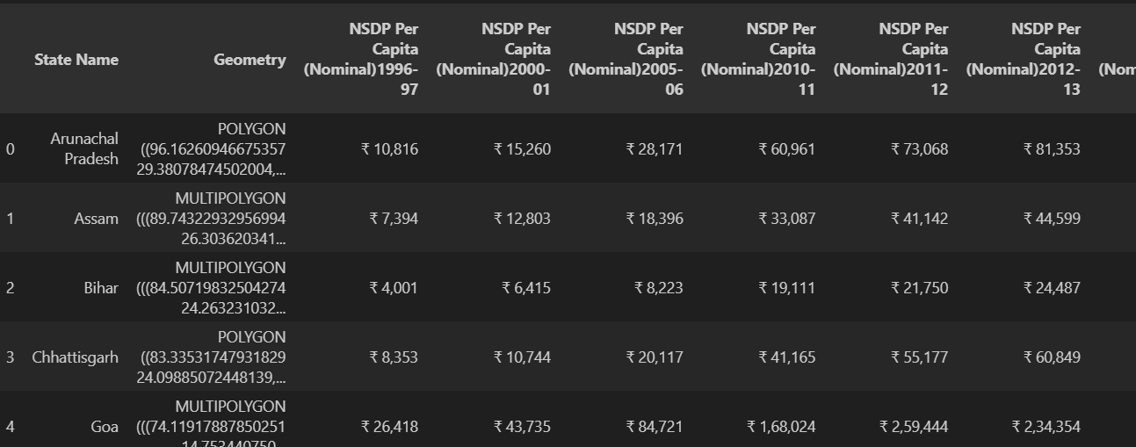
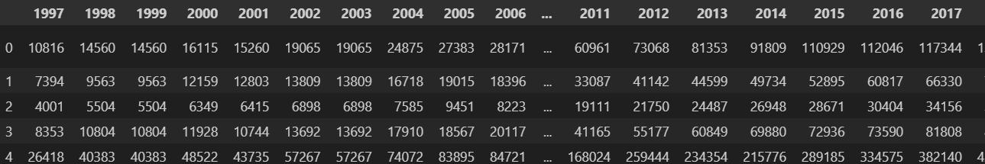
Data preprocessing
data restructuring

Slide 8
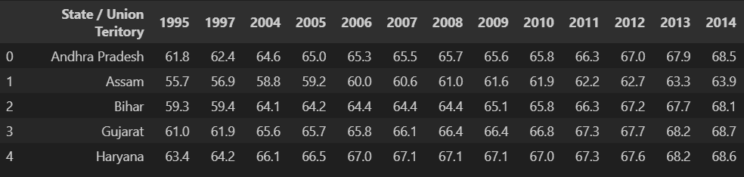
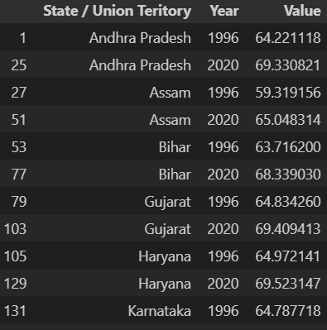

Slide 9
Outlier Removal
The missing data was imputed using a machine learning algorithm. Linear Regression and Random Forest were tested, and Random Forest was chosen for its superior model performance in evaluation.

Slide 10
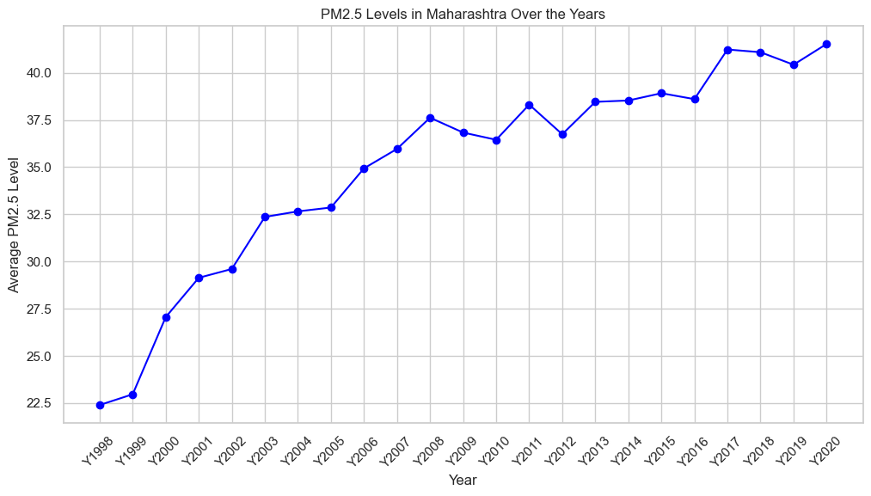
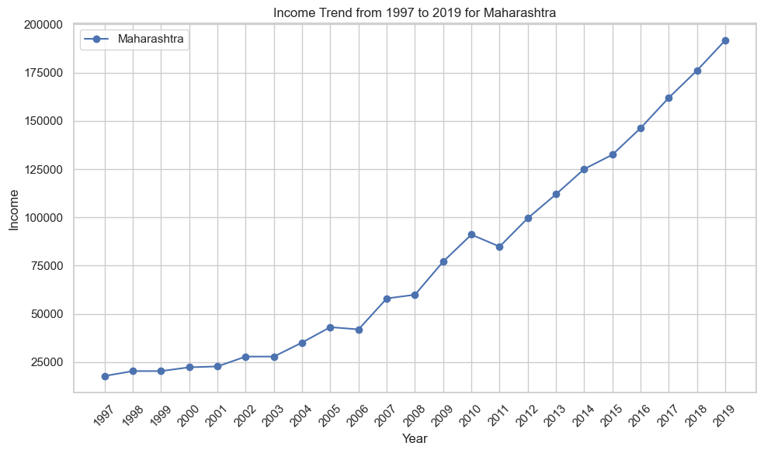
Data Analysis

Slide 11
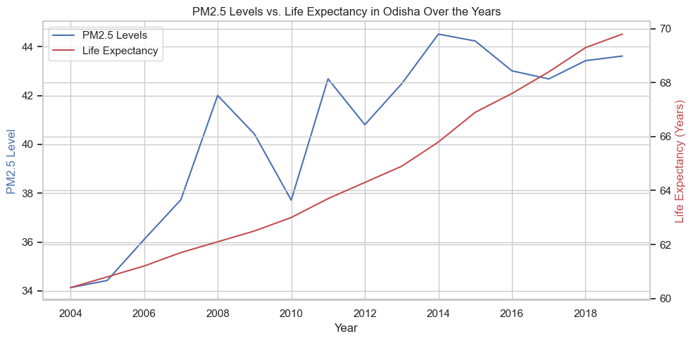

Slide 12
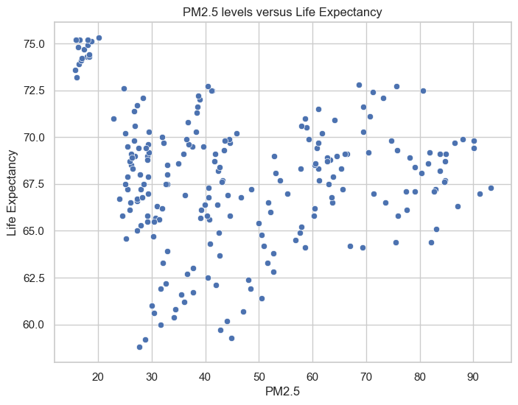

Slide 13
Potential for Machine Learning
To corelate the increase in pollution to decrease in life expectancy.
To estimate the life expectancy increase when existing policies are implemented.
To estimate the life expectancy increase when welfare schemes are expanded.
To estimate the life expectancy increase when investment to hospitals in increased.
To estimate the life expectancy increase when investment to sanitation in increased.
To compare states on the effect of pollution to life expectancy.
To see how policy changes will best help people in which region.
How much income has an effect on life expectancy.
Gross estimation on the percent to which life expectancy is dependent on GDP(Income) and pollution.
Urban v Rural split.
Explore more data via including existing comorbidities to estimate the lives saved by implementing existing standards.

Slide 14
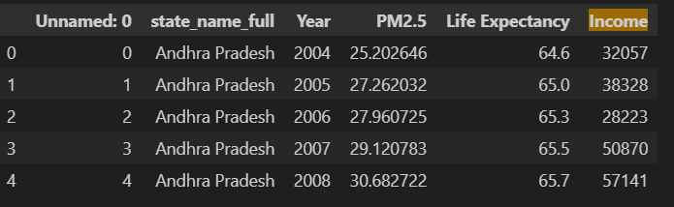
Name | MAE | MSE | R2
Linear Regression | 2.07886 | 7.936533 | 0.4757117
DT Regressor | 2.07885 | 7.936233 | 0.47574

Slide 15
Any Questions ?

